Slide 1




Final Year Project Presentation
Software Engineering Department
Sir Syed University of Science and Technology

Slide 2


Project-50 DATA PULSE (Empower Insights Through Innovation)
Supervised By
Mr. Sarfaraz Ahmed Sattar Natha
Associate Professor
02

Slide 3



Team Members and Work Distribution
Abdul Moiz Chishti
BSE-2020F-022 (GL)
Documenting,Development of
Model Comparison module
Syed Abdul Aleem
BSE-2020F-042
Documenting, Development of
reports Generation Module
Shaheer Khan Qureshi
BSE-2020F-003
Documenting, Research,
and development
of models Comparison Reports
03

Slide 4

Problem Statement
In today's data-driven landscape, organizations and individuals face formidable challenges in efficiently harnessing vast datasets for meaningful insights.
Challenges:
Data Profiling Complexity:
Understanding intricate datasets is challenging due to their diversity and volume.
Automated techniques are essential for comprehensive data exploration and analysis.
Model Selection Ambiguity:
The abundance of machine learning algorithms makes selecting the most suitable model daunting.
A systematic approach is required to compare and evaluate multiple models based on unique data characteristics.
Lack of Accessibility:
Obtaining and integrating the trained model into applications should be straightforward.
The absence of an accessible means to download the trained model in a deployable format limits practical application.
04

Slide 5
Idea /Solution
Project Objectives:
Develop an automated system for in-depth data profiling.
Conduct thorough comparisons of multiple machine learning models.
Enable users to easily download selected and trained models.
Solutions:
Automated Data Profiling:
Implement techniques to explore and analyze data comprehensively.
Systematic Model Comparison:
Provide a structured approach to evaluate and compare various machine learning algorithms.
Accessible Model Retrieval:
Facilitate easy downloading of trained models in deployable formats.
Impact:
Empower users to derive actionable insights.
Seamlessly integrate machine learning solutions into workflows.
Democratize access to advanced analytics and foster a culture of data literacy across industries.
05

Slide 6

Platform Capabilities
Scope and Purpose
Scope
Develop an end-to-end platform that automates the data profiling process.
Employ advanced techniques to explore and analyze datasets.
Provide a comparison of multiple machine learning models.
Evaluate performance metrics based on specific dataset characteristics.
Generate a detailed report outlining comparison results.
Offer the option to download the trained model in a deployable format.
Purpose
Empowers Non-Technical Users
Accelerates the Data Analysis Process
Enhances Accessibility to Machine Learning
Provides a Comprehensive Solution
Supports Continuous Learning and Improvement
Benefits
Ensure ease of integration into various applications.
Aim to bring better results by using and implementing various techniques.
06

Slide 7
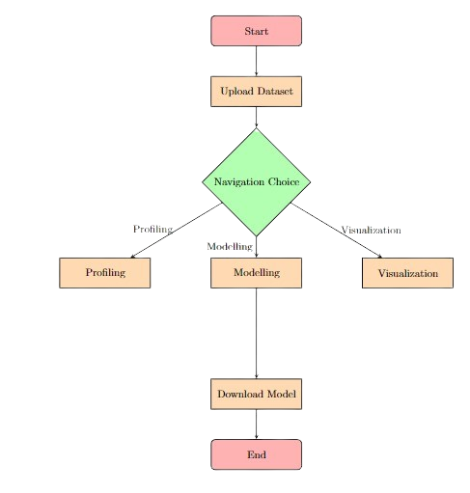
System Diagram
07

Slide 8
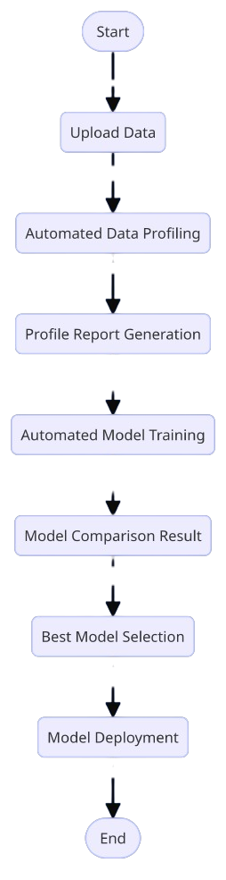
Flow Chart
08

Slide 9





Hardware and Software Components
09

Slide 10
Developed Data Pulse, an all-in-one solution to address challenges in data profiling and machine learning model selection.
Automates data profiling and model selection processes, making data-driven decision-making more accessible and efficient.
Enables organizations to leverage data without requiring extensive technical expertise.
Performs detailed data profiling to assess the structure, quality, and key characteristics of datasets.
Evaluates multiple machine learning models using various performance metrics, including accuracy, precision, recall, and F1 score, to identify the optimal model.
Generates comprehensive reports summarizing findings and recommendations for informed decision-making.
Methodology
10

Slide 11
Observations and Results
Automated Data Profiling:
Conducted comprehensive exploration to reveal statistical characteristics within datasets.
Generated visual representations (charts, graphs) to aid in understanding data distributions and relationships.
Provided detailed statistical summaries for each feature or attribute.
Machine Learning Model Comparison:
Supported comparison across various machine learning algorithms (regression, classification, etc.).
Evaluated model performance using standard metrics like accuracy, precision, recall, F1-score, and ROC curves.
Automated the training of multiple models to find the best performance.
Model Training and Selection:
Successfully trained and saved the best models for future use.
Automated the setup of the PyCaret environment for model comparison.
Allowed exporting of processed data and model results for further use.
11

Slide 12
Project and Product
Product Overview:
The platform automates data profiling, machine learning model comparison, and model selection.
Utilizes tools like PyCaret and Streamlit for easy data upload, cleaning, preprocessing, and visualization.
Allows users to run automated machine learning and download trained models for deployment.
Project Scope:
Develop an end-to-end platform to automate data profiling and model comparison.
Evaluate performance metrics based on dataset characteristics.
Generate detailed reports with comparison results.
Provide easy integration of trained models into various applications.
System Features:
Automated data profiling and exploratory data analysis.
Machine learning model comparison with performance metrics evaluation.
Automated training, selection, and saving of the best models.
Basic visualization using Matplotlib and Seaborn.
Exporting of processed data and model results for further use.
12

Slide 13
Business Model
Target Audience: SMEs Educational Institutions Government Agencies Pricing Strategy: Premium Model Free Tier: Basic features Single User: $20/month Enterprise Packages: $100/month Revenue Streams: Subscriptions Consulting Services Partnerships Advertisements (Free Tier) | Cost Structure: Development & Maintenance Customer Support Marketing & Sales Operational Costs Marketing Strategy: Social Media Campaigns Educational Webinars Local Partnerships Referral Programs Value Proposition: Affordable advanced data analysis User-Friendly platform Localized Support for the market
13

Slide 14


Future Scope
The motivation behind this project lies in the growing need for effective data analysis and model selection in a data-rich environment. By simplifying these processes and making them more accessible, the project seeks to empower users to make informed decisions and maximize the potential of their datasets. The goal is to democratize machine learning and enable broader adoption across various industries and applications.
The project encompasses the development of an automated system that conducts comprehensive data profiling using advanced techniques. It will analyze datasets, compare multiple machine learning models, evaluate their performance metrics, and generate detailed reports outlining the comparison results. Additionally, the system will provide users with the option to download the trained model in a deployable format for seamless integration into various applications
15

Slide 15
Conclusion
The significance of automating data profiling, EDA, and machine learning model’s selection is to address the challenges faced by organizations and individuals in leveraging data for insights. While existing tools and frameworks offer partial solutions, there is a need for an integrated platform that simplifies these processes, making machine learning accessible to a broader audience. Data Pulse aims to fill this gap by providing an end-to-end solution that automates data profiling, compares multiple machine learning models, and facilitates easy deployment, thus empowering users to harness the full potential of their data
16

Slide 16
THANK YOU
17

